Slide 1
©2018 Florida Polytechnic University
AA000000
Workday 32
Alicia Maule
January 14, 2019

Slide 2
Agenda
Workday Feature Releases
5 Week Preview Preparation Window
What’s New in Workday Report
Testing the Feature Release
Feature Release Resources
Workday 32 // AA000000
Florida Polytechnic University // 2

Slide 3
Workday Feature Releases
2 Feature Releases Per Year
New Features and Functionality
Advanced Visibility
Sandbox Preview – Opened 02/02/19
One Window
Feature Release Delivered to all Tenants
Compliance Updates
New Products
5 Week Release Preparation Window
March 9, 2019.
Workday 32 // AA000000
Florida Polytechnic University // 3

Slide 4
Release Schedule
Workday 32
February 4, 2019–
Features available in Preview
March 9, 2019–
WD 32 will be available in ALL Tenants
Workday 33
August 3, 2019 –
Features available in Preview
September 7, 2019–
WD 33 will be available in ALL Tenants
Workday 32 // AA000000
Florida Polytechnic University // 4

Slide 5
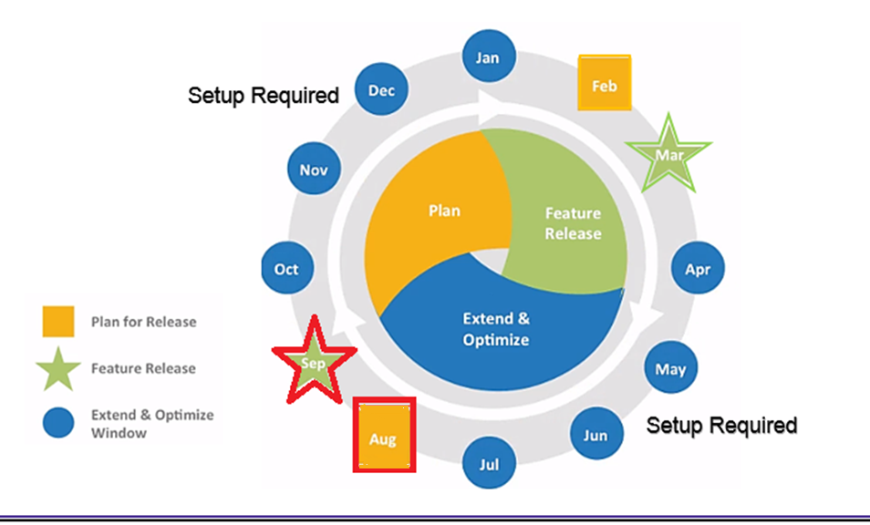
Yearly Lifecycle
Workday 32 // AA000000
Florida Polytechnic University // 5

Slide 6
5 Week Preview Preparation
Window
5 Week Preview Testing Window
February 2 | WEEK 1 February 4th – 8th | WEEK 2 February 11th – 15th | WEEK 3 February 18th – 22nd | WEEK 4 February/March 25th – 1st | WEEK 5 March 4th – 8th
Workday 32 Feature Release Prep
What’s New in Workday Report Available in Preview
WD32 Features Available in Preview Tenant
~
5 Week Preview Window Open
March 9th:
WD 32 Features Delivered to ALL Tenants
Testing
Florida Poly Testing begins on February 4th
Testing signoff due on March 5th
Job Aids and Training
Workday 32 // AA000000
Florida Polytechnic University // 6

Slide 7
What’s New in Workday Report
Standard Workday Report
Reflects All Enhancements Delivered to the Preview Tenant for the WD 32 Release
Run Report in Preview Tenant
Updated Weekly
Workday 32 // AA000000
Florida Polytechnic University // 7

Slide 8
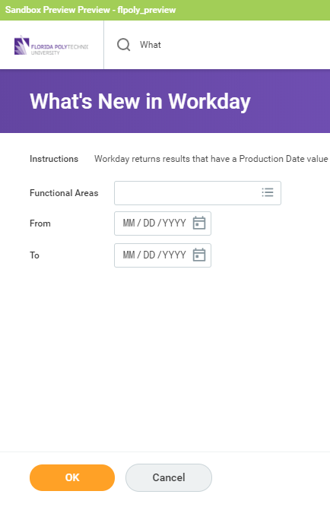
Step 1 – Run the What’s New in
Workday Report
1. Open the Florida Poly Preview Tenant
2. Type What’s New
3. Select Functional Area(s) by Clicking on the Prompt Symbol
4. Enter From and To Dates
To view all enhancements that Workday has delivered to the Preview tenant since the Workday 29 release, run the report using 09-10-17 as the start date (this is the Sunday after WD delivered Workday 30 to our Production tenant) and leave the end date blank. These are the features intended to move to Production on 03-10-18 as part of the Workday 30 Release.
5. Click OK
Workday 32 // AA000000
Florida Polytechnic University // 8

Slide 9
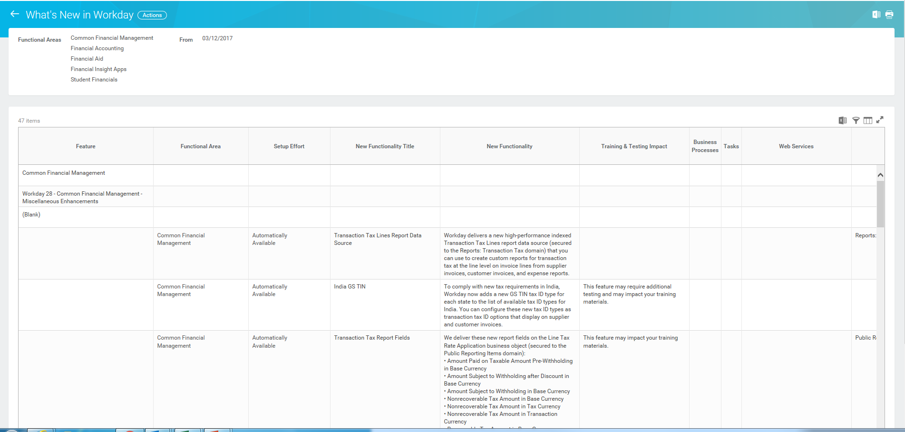
Step 2 – Export the Report to Excel
Export to Excel
Workday 32 // AA000000
Florida Polytechnic University // 9

Slide 10
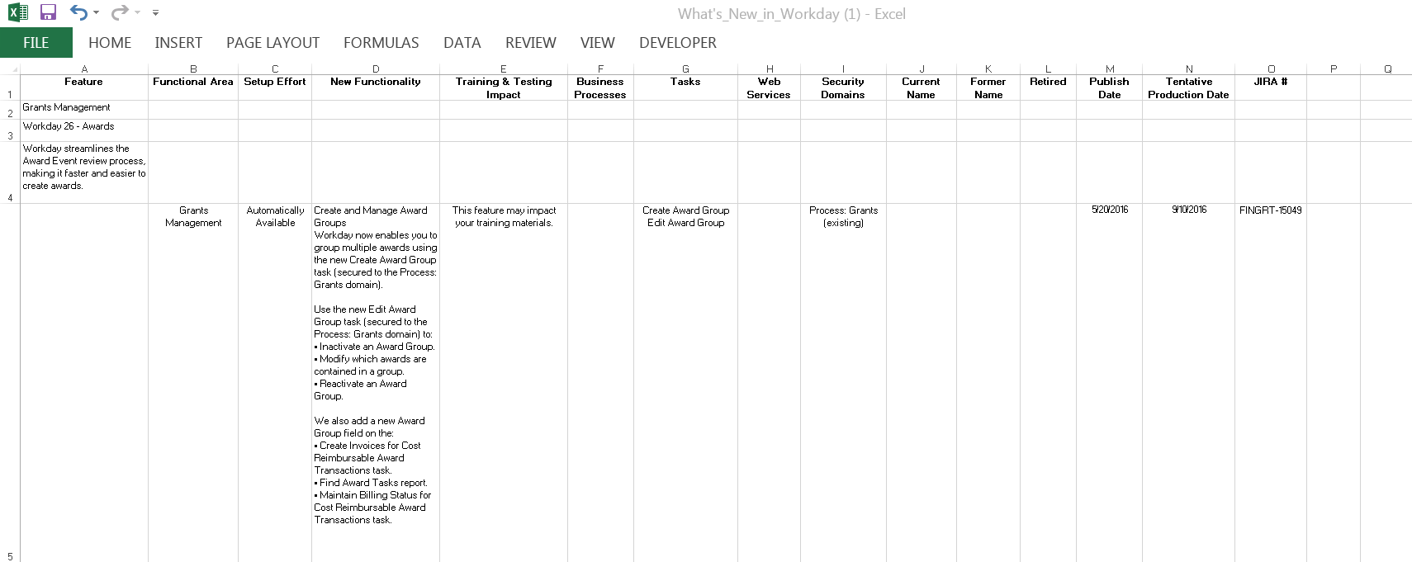
Step 3 – Review and Save the Excel
Report
Add a NOTES Column
Automatically Available or Setup Required?
Will this impact Training and Job Aids?
Add a SIGNOFF Column. Include Initials and Date of Sign-Off
Workday 32 // AA000000
Florida Polytechnic University // 10

Slide 11
Setup Effort (column C)
Automatically Available
This functionality is automatically available and is the testing focus during the 5 week window (see purple rows in Announcing and Feature considerations Workday 32 All – Distribution.xlsx)
Setup Required (Uptake)
Items that need to be configured to uptake the new functionality
Must perform setup tasks to take advantage of these features
Workday recommends uptake to take place during the Extend & Optimize window (4 months)
Please evaluate these and work with Enterprise Systems to complete set up and change management for those you wish to implement.
Workday 32 // AA000000
Florida Polytechnic University // 11

Slide 12
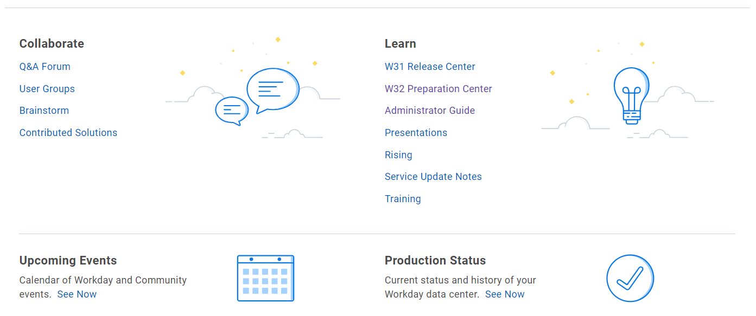
Service Update Notes are available from the Community homepage in the Learn section. A RELEASE PREPARATION tag to help track additional features added and delivery date revisions during the five week window
Workday 32 // AA000000
Florida Polytechnic University // 12

Slide 13
Setup Effort (column C)
Automatically Available
This functionality is automatically available and is the testing focus during the 5 week window
Setup Required (Uptake)
Items that need to be configured to uptake the new functionality
Must perform setup tasks to take advantage of these features
Workday recommends uptake to take place during the Extend & Optimize window (4 months)
Workday 32 // AA000000
Florida Polytechnic University // 13

Slide 14
Step 4 – Test!
Run and review output from critical integrations before beginning any testing which may change the output
5 Week Testing Efforts
INTEGRATIONS
CRITICAL BUSINESS PROCESSES
CRITICAL CUSTOM REPORTS
SYSTEM DATA VALIDATIONS
Run critical custom reports to review for any changes
Test critical business processes to confirm the process and results are as expected
Validate existing system data
Workday 32 // AA000000
Florida Polytechnic University // 14

Slide 15
Testing Recommendations
Use Sandbox Preview Tenant Exclusively when testing Automatically Available Features during 5 week Testing window.
NOTE:
Changes made in Sandbox Preview Tenant during testing are not migrated to Production during the Feature Release.
Immediately after the conversion to Production, any configuration or setup changes identified during testing in Preview MUST manually be configured or setup in Production.
Workday 32 // AA000000
Florida Polytechnic University // 15

Slide 16
WD32 Preparation Center
Feature Release Guidebook
A framework for developing a plan and a repeatable process to be executed each release
Feature Delivery During the Release Preparation Window
How Workday provides information on feature deliveries and updates during the 5-week release preparation window
Announcing and Feature Considerations Document
A general guide on how to read Announcing and Feature Considerations
Testing the Feature Release
How NSCs can request a refresh of their Sandbox Preview tenant from Production
How to Use the What's New Report
A general guide on how to read the What's New in Workday report
Workday Adoption
How to use the Adoption Planning dashboard to view and report on your uptake of new features and enhancements in Workday
Workday 32 // AA000000
Florida Polytechnic University // 16

